Slide 1
Cyclistic Bike Share Data Analysis for speedy Success A case study provided by Google Data Analytics Program
By Nisha Bharti

Slide 2
Contents
Introduction
Business Case
Data Analysis Process
Process phase of Cyclistic bike share dataset
Clean Phase of Cyclistic bike share dataset
Analyze and Visualization phase
Conclusions
Recommendations

Slide 3
Introduction
Cyclistic is a bike-sharing company located in Chicago. This company offers reclining bike, hand tricycles, cargo bikes and bikes for people with disablities.
There are two type of rides provided by company.
1. Casual rides
Single ride pass holders
Full day Pass holders
2. Rides provided to Annual members
Business Case
Goal is to maximize the number of annual subscription of riders.
Objectives of the case study
How do annual members and casual riders use Cyclistic bikes differently?
Why would casual riders buy Cyclistic annual memberships?
How can Cyclistic use digital media to influence casual riders to become members?

Slide 4
Data Analysis Process
Ask
Prepare
Process
Cleaning
Analyze
Visualize
Act
We are using R Programming for Cyclistic dataset analysis.
No Ask phase in our case study since we have already been provided dataset with expectations.

Slide 5
Cyclistic Bike Share Data Analysis to maximize the member riders
Data Preparation
Access to Kaggle Dataset has been provided by Google Data Analytics program.
Downloaded and worked on the data for a year starting from July 2021 to June 2022
Data processing
Data was in csv file for each month so merged them to create a single file. compared the data files to each other before merging to verify if they can be merged.
Data Cleaning
Data needs to be cleaned before analyze it.
Checked the accuracy and consistency of data and removed inconsistent and inaccurate data
Removed incomplete data row of dataset.
Remove duplicates.

Slide 6
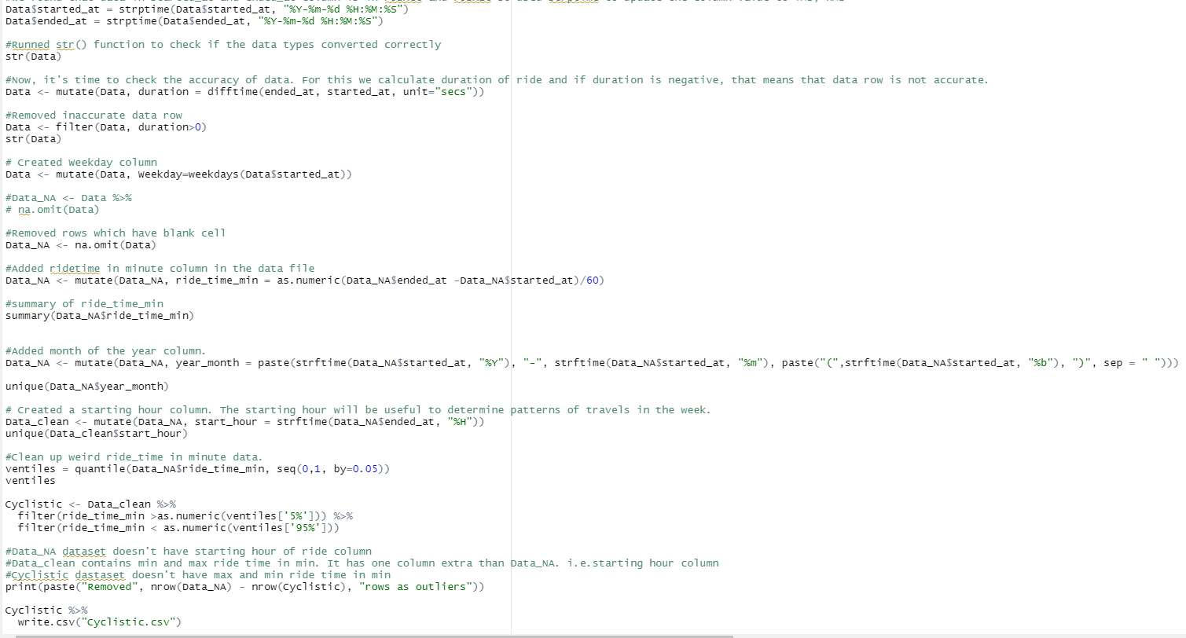
Data Cleaning

Slide 7
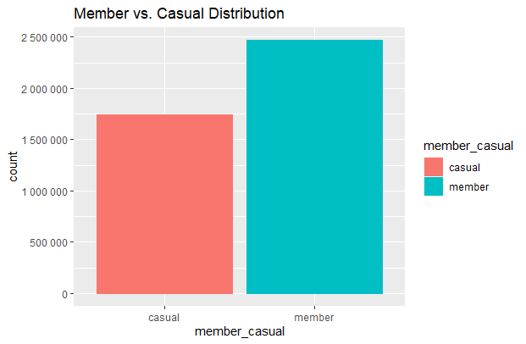
Annual Member rider versus Casual riders
Annual members count is greater than causal riders.
Difference = (24,68,902 - 17,40,060) = 7,28,842
Count of annual members are 7,28,842 more than casual riders.

Slide 8
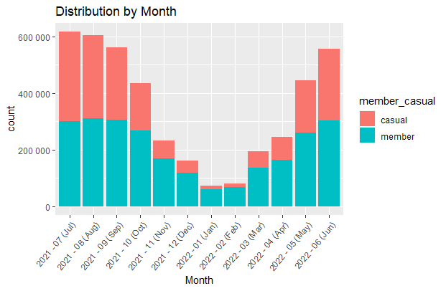
Monthly distribution of members and casual riders
Annual members count is more by 40% or more than 40% in the month of Nov 2021,Dec 2021, Jan 2022, Feb 2022 and March 2022.
People ride Cyclistic bike more in the month of July. i.e. Count of rider is more in July and start decreasing and it is minimum in January.
People ride bike in summer months starting from May to October.
There is approximately even split of casual and annual member riders in warmer month
Annual member ride bike more as comparison to casual riders in winter season.

Slide 9
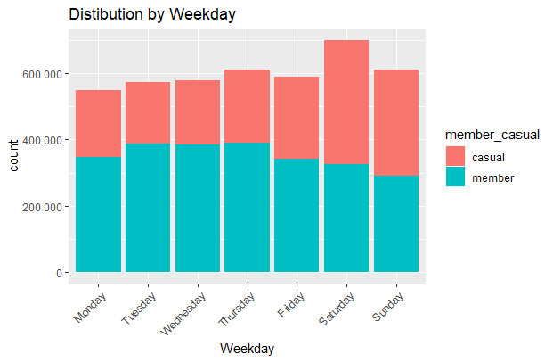
Weekday Distribution of annual and casual riders
Casual rider over weighs member riders on Saturday and Sunday of the week.
riders count is more on weekends
Count of riders is maximum on Saturday.

Slide 10
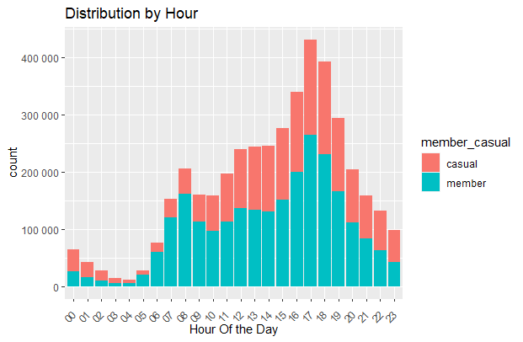
Hourly Distribution of annual and casual riders
People ride cyclistic bike mostly in the late afternoon and early evening starting from 2:30 PM to 7:30 PM.
Count of people is maximum from 6:30 to 7:30 PM i.e. the time when people come back to their home from office.
Members ride the bike more from 5:00AM to 10:00PM.
Count of members is approximately more than twice from 5:00 AM to 9 PM.

Slide 11
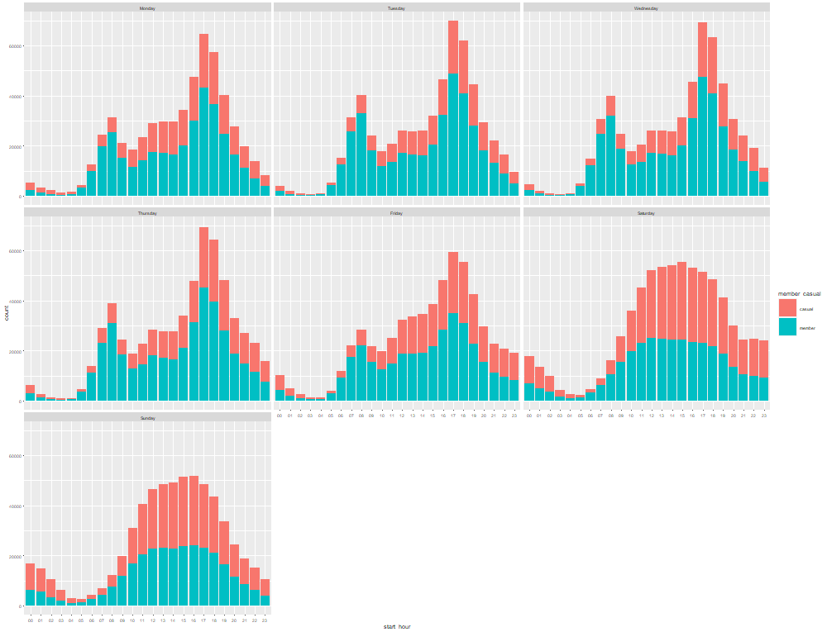
Hourly distribution by day of annual and casual riders
Members riders over weigh Casual rider on weekdays while casual riders over weigh on weekends
Count of members is approximately double of Casual riders on weekdays
Casual rider count on weekend is maximum from 10:30 AM to 6:30 PM
Member riders count is more in commuter hours i.e. from 3:00 PM to 7:00 PM

Slide 12
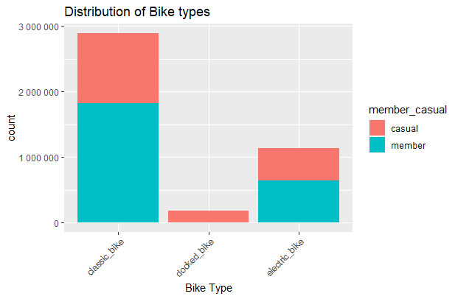
Data distribution by bike type
Member doesn't ride docked_bike.
Member ride classic and electric bike more as compare to casual riders.
Rider prefer to ride classic bike more and doesn't prefer to ride docked bike.
Member riders prefer classic bike over other bike types

Slide 13
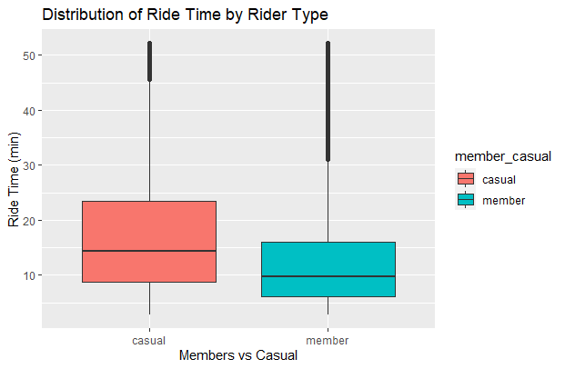
Rider type data distribution by ride time
Average Ride time of casual riders over weigh members.

Slide 14
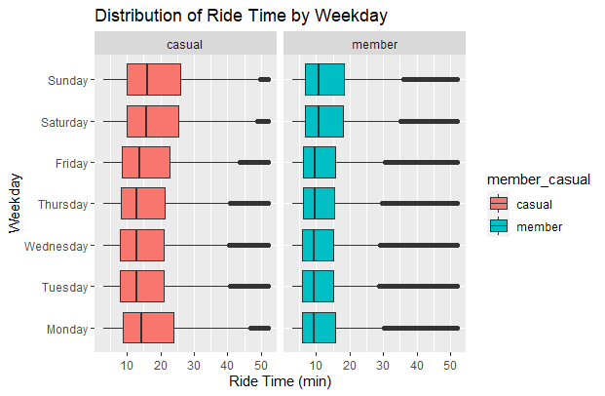
Ride time compare by weekday
Ride time of member on weekdays is consistent.
Ride time average is more on weekends as compare to weekdays
Ride time of casual riders is fluctuating. It is maximum on Monday, Saturday and Sunday for casual riders and minimum and consistent on Tuesday, Wednesday and Thursday.

Slide 15
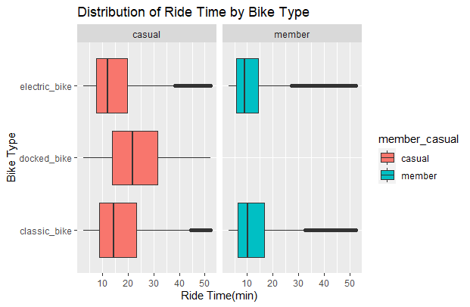
Ride time compared by bike type
Electric-bike's average ride time is minimum for both member and casual riders.
Docked-bike's average ride time is maximum for casual riders but ride time for this bike type is zero for members.
Classic bike's ride time for both casual and member riders is longer as compare to other bike types.

Slide 16
Conclusions
Riders prefer to ride in Summer. Riders count is maximum in summer and it decreases and is minimum in winter season.
Casual rider over weighs member riders on Saturday and Sunday of the week.
Annual riders over weight casual riders on weekdays during Commuter hours
Member doesn't ride docked_bike.
Classic bike riders count is maximum and docked bike riders is minimum.
Average Ride time of casual riders over weigh members. That means casual riders use the bike for vacation/ visiting tourist places.
Ride time average is more on weekends as compare to weekdays
Classic bike's ride time for both casual and member riders is longer as compare to other bike types.
Electric-bike's average ride time is minimum for both member and casual riders.

Slide 17
Recommendations
We observed from our analysis that ride time of casual several times more than annual members so we can offer better rental structure for long term bike holding. For members, we can provide them more facility like – members have not to worry about when to return the bike.
The company can have a pact with ice-cream shop and cold drink shop to provide members free drink in summer season and hot coffee and such free snack in summer season. We can also run the campaign just before the summer season starts and can tell people benefits of using Cyclistic bike.
We have observed that riders count and average ride time is more on weekends. Here we can partner with tourism company like trip advisory, make my trip, Goibibo etc and Hotels and companies which provide accommodation facility like Oyo in a tourist place to offer discount to Cyclistic members.
Seasonal nature of bike use has been seen so to increate the membership, we can provide seasonal nature of membership i.e. membership for 3 months, 6 months 9 month and 12 months.
We observed through analysis that riders count is minimum in winter season. We can give discount and free trails to new users for increasing the count of riders in winter.
We can promote all these newly added scheme through Facebook, You tube, Instagram, TV ads etc.

Slide 18


